Slide 1
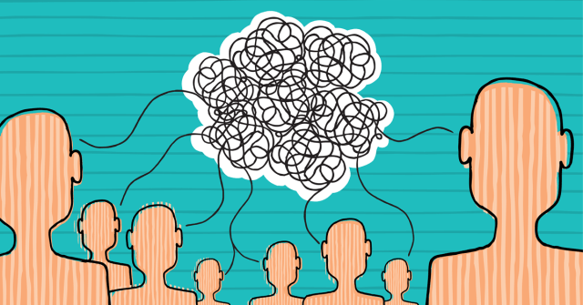
Communication difficulties of society.

Slide 2
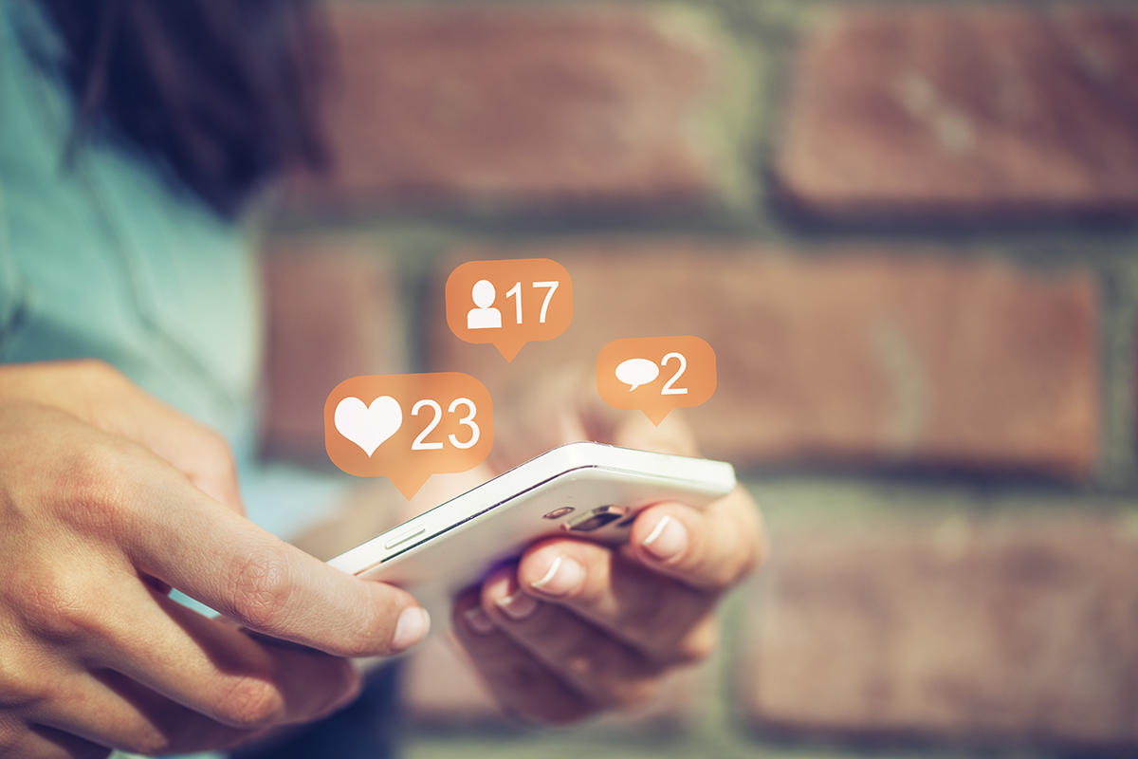
Reality Communication between social networks.

Slide 3
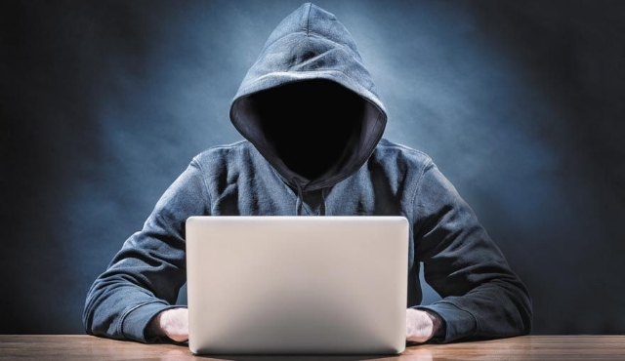
Who is it?

Slide 4
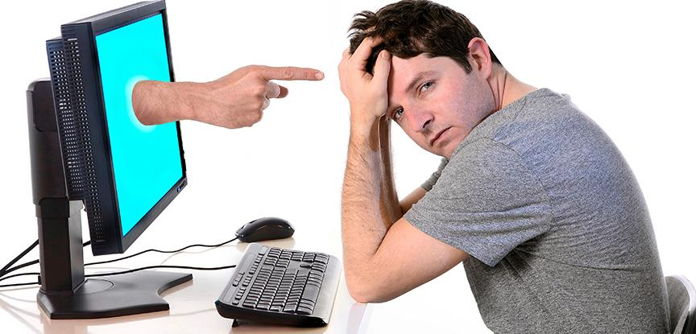
How to improve it?

Slide 5
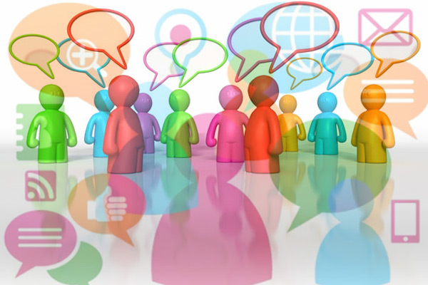
Different thoughts and opinions.
Different communities.

Slide 6
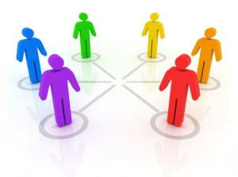
avoid less disagreements
improve knowledge

Slide 7
End
Kaue Vinicius da Silva Sousa

